Slide 1
Fall detection/prediction
電機四 B05901038 陳元芃
電機四 B05901164 曹峻豪
電機四 B05901071 孫鍾恩

Slide 2
Motivation
Falls in the elderly have always been a serious medical and social problem. To detect and predict falls, a hidden Markov model (HMM)-based method using tri-axial accelerations of human body is proposed

Slide 3
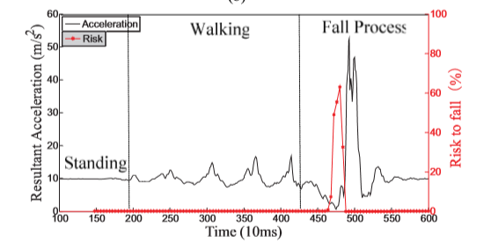
How to realize ?
We train three hmm models for running, walking , falling prediction and falling. Each model has three states and eight observations. The window size (observation sequence length) is 1.5sec with stride equals to 0.01sec.
Red line would be the desired output probability of the model of falling predict that we intend to achieve

Slide 4
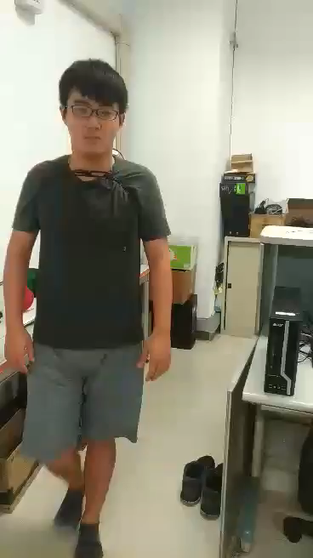
Training
Collect the dataset:
31 samples for predict fall
31 samples for falling
17 samples for running
16 samples for walking

Slide 5
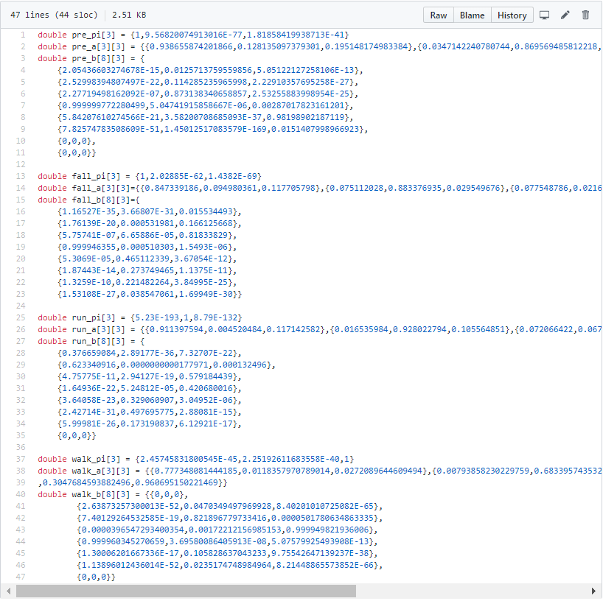

Slide 6
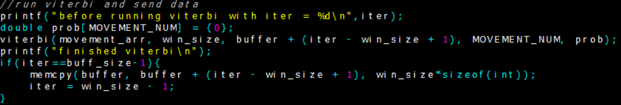
Data structure – sliding window implementation

Slide 7
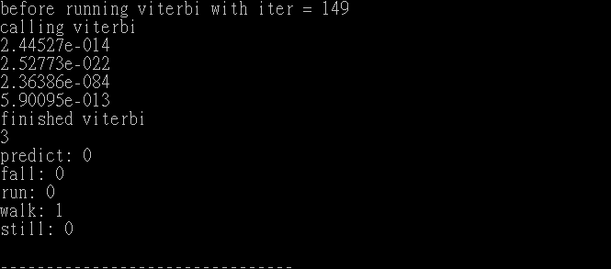
Testing result - walk

Slide 8
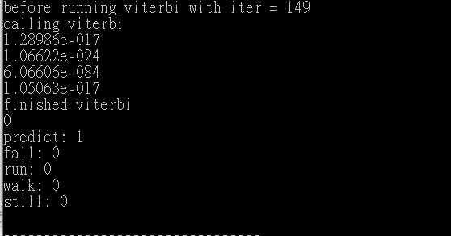
Testing result - pre

Slide 9
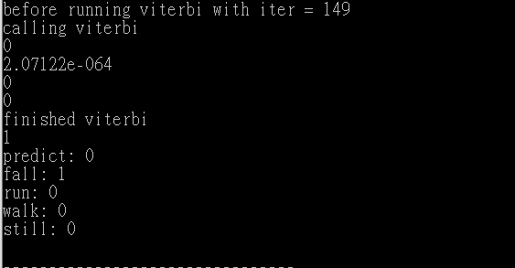
Testing result – fall

Slide 10
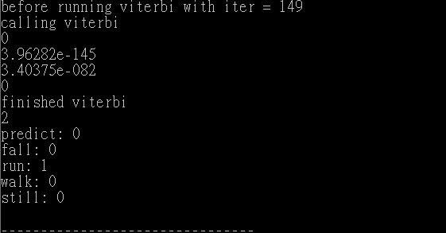
Testing result – run

Slide 11
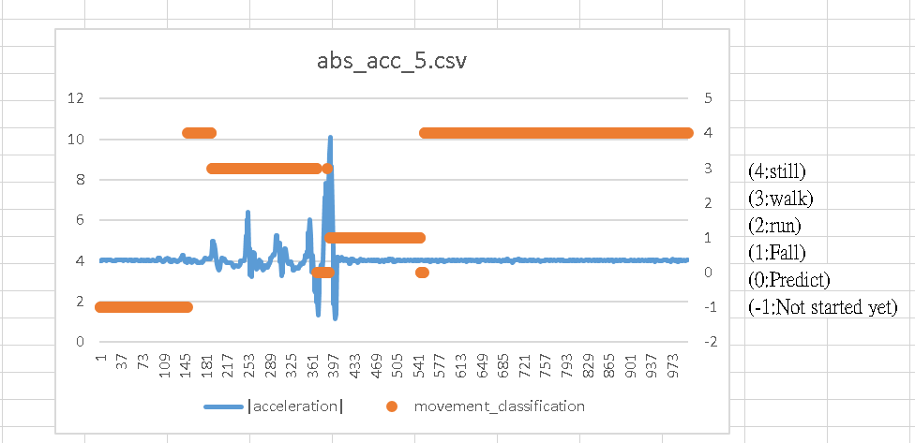
Inference result

Slide 12
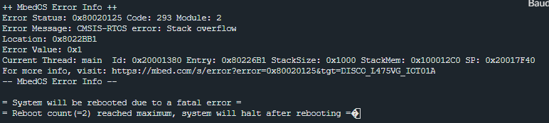
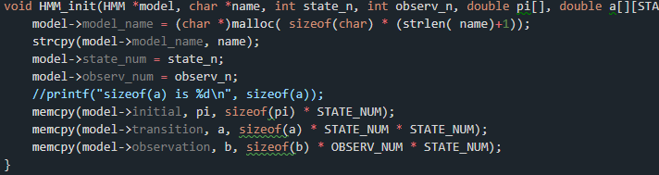
Error message in mbed

